Slide 1
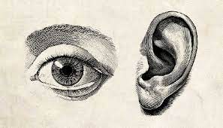
Sensory Disorders

Slide 2
Module Learning Objectives
Analyze
Analyze assessment and diagnostic findings used in the evaluation of ocular and otic disorders.
Describe
Describe the clinical features, assessment findings, and medical-surgical and nursing management of patients with ocular disorders.
Describe
Describe the clinical features, assessment findings, and medical-surgical and nursing management of patients with otic disorders.
Identify
Identify methods to effectively communicate with a person with a hearing or vision disorder.

Slide 3
Module Content
Diagnostic studies of the eye and vision
Visual impairment and blindness
Glaucoma
Cataracts
Retinal detachment
Macular degeneration
Conjunctivitis
Diabetic retinopathy
Enucleation
Diagnostic studies of the ear and hearing
Hearing loss, hearing impairment, deafness
Cochlear implantation
Cerumen impaction
Otitis externa
Otitis media
Tympanic membrane rupture
Ménière Disease
Ototoxic medications

Slide 4
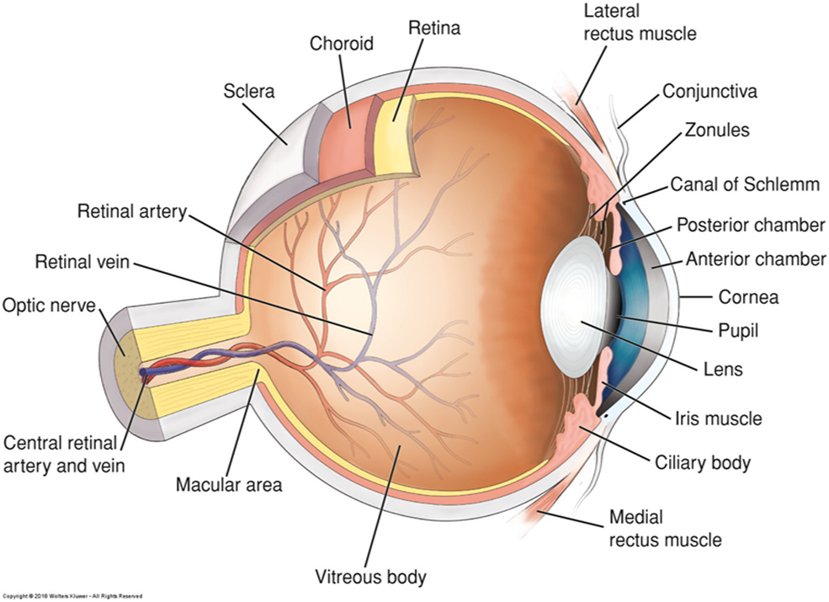
Anatomy of the Eye

Slide 5
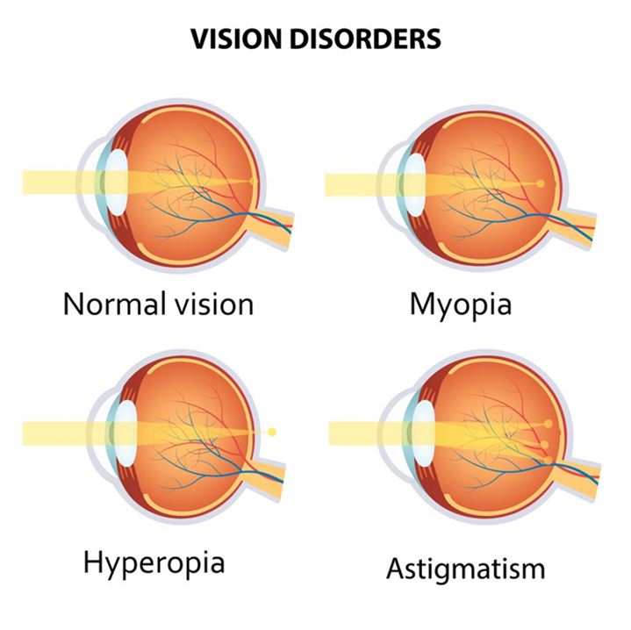
Refractive Errors
Emmetropia = Normal vision
Myopia
  Nearsighted and have blurred distance vision
Hyperopia
  Farsighted, have excellent distance vision but blurry near vision
Astigmatism
  Image distortion due to curvature of the cornea

Slide 6
Vision Impairment & Blindness
Vision impairment
Central visual acuity of 20/40 or worse in the better eye with the best possible correction
Low vision
Visual impairment that requires the use of devices and strategies to perform visual tasks
Blindness
Best possible corrected central visual acuity ranges from 20/400 to no light perception
Legal blindness
Condition of impaired vision with central visual acuity of 20/200 or worse or a visual field diameter of 20 degree or less
What are some common causes of blindness?

Slide 7
Answer: common causes of blindness
Worldwide: uncorrected refractive error and cataract are the two leading causes; then glaucoma, age-related macular degeneration, diabetic retinopathy, corneal scarring (trachoma, vitamin A deficiency) and childhood blindness.
United States: diabetic retinopathy (leading cause in working-age adults), age-related macular degeneration (leading cause over 60), glaucoma (disproportionately Black and Hispanic clients), cataract, retinal detachment, trauma and eye infections.
Risk factors the nurse can act on: uncontrolled diabetes and hypertension, smoking, UV exposure, missed eye exams, steroid use, and family history.

Slide 8
What strategies might the nurse use providing care and interacting with a client who is blind?
What strategies would the nurse include in the plan of care for clients with low vision and blindness?

Slide 9
Answer: caring for the client who is blind or has low vision (1 of 2)
Interacting with a client who is blind
  Announce yourself by name when you enter and say when you leave; speak in a normal voice directly to the client, not the companion.
  Explain everything before you touch or do it; describe the room, food by clock position, and where the call light and belongings are.
  Offer your elbow and walk a half-step ahead to guide; never push or pull; say when you reach steps, doors or chairs.
  Do not move furniture or belongings without telling the client; keep doors fully open or fully closed.

Slide 10
Answer: caring for the client who is blind or has low vision (2 of 2)
Plan of care for low vision and blindness
  Safety: orient to the room, clear pathways, night light, bed low, call light within reach, fall-risk precautions.
  Adaptive devices: magnifiers, large-print and audio materials, talking glucometers and clocks, high-contrast labels, good lighting without glare.
  Medications: teach by touch (rubber bands, raised dots, pill organizers), have the pharmacy print large labels; involve family.
  Referrals: low-vision rehabilitation, orientation and mobility training, community agencies, transportation, support groups; assess mood and isolation.

Slide 11
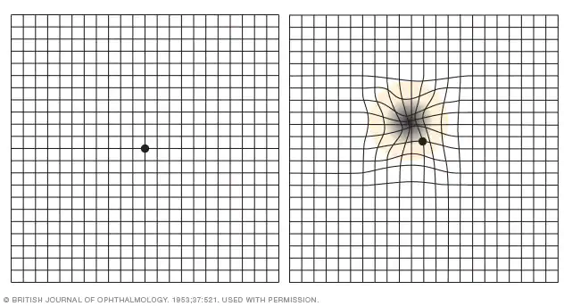
Diagnostics
Amsler grid ​
Ophthalmoscopy​
Slit-lamp examination​
Tonometry​
Color vision testing​
Amsler grid ​
Ultrasonography​
Fluorescein and indocyanine green angiography​
Perimetry testing (visual field testing)

Slide 12
Ocular Medications
Objective of ocular medication delivery: maximize the amount of medication that reaches the ocular site of action in sufficient concentration to produce a beneficial therapeutic effect
Discuss nursing interventions for ocular medications.

Slide 13
Answer: nursing interventions for ocular medications
Wash hands; check the right eye (OD right, OS left, OU both) and the label – eye drops are not the same as ear drops.
Tilt the head back, pull the lower lid down into a pocket, look up; drop into the conjunctival sac, never onto the cornea; do not let the tip touch the eye or lashes.
Close the eye gently (no squeezing) and press the inner canthus for 1–2 minutes (punctal occlusion) to keep the drug out of the tear duct and reduce systemic effects – important with beta-blocker drops (timolol) in clients with asthma, heart failure or bradycardia.
Wait 5 minutes between different drops; drops before ointment; ointment as a thin ribbon along the lower lid; blurred vision after ointment is expected.
Wipe from inner to outer canthus with a clean tissue for each eye; remove contact lenses before drops and wait 15 minutes to reinsert.
Teach the client the schedule, never to share bottles, to discard opened bottles per label, and to report increased pain, redness, drainage or vision change.

Slide 14
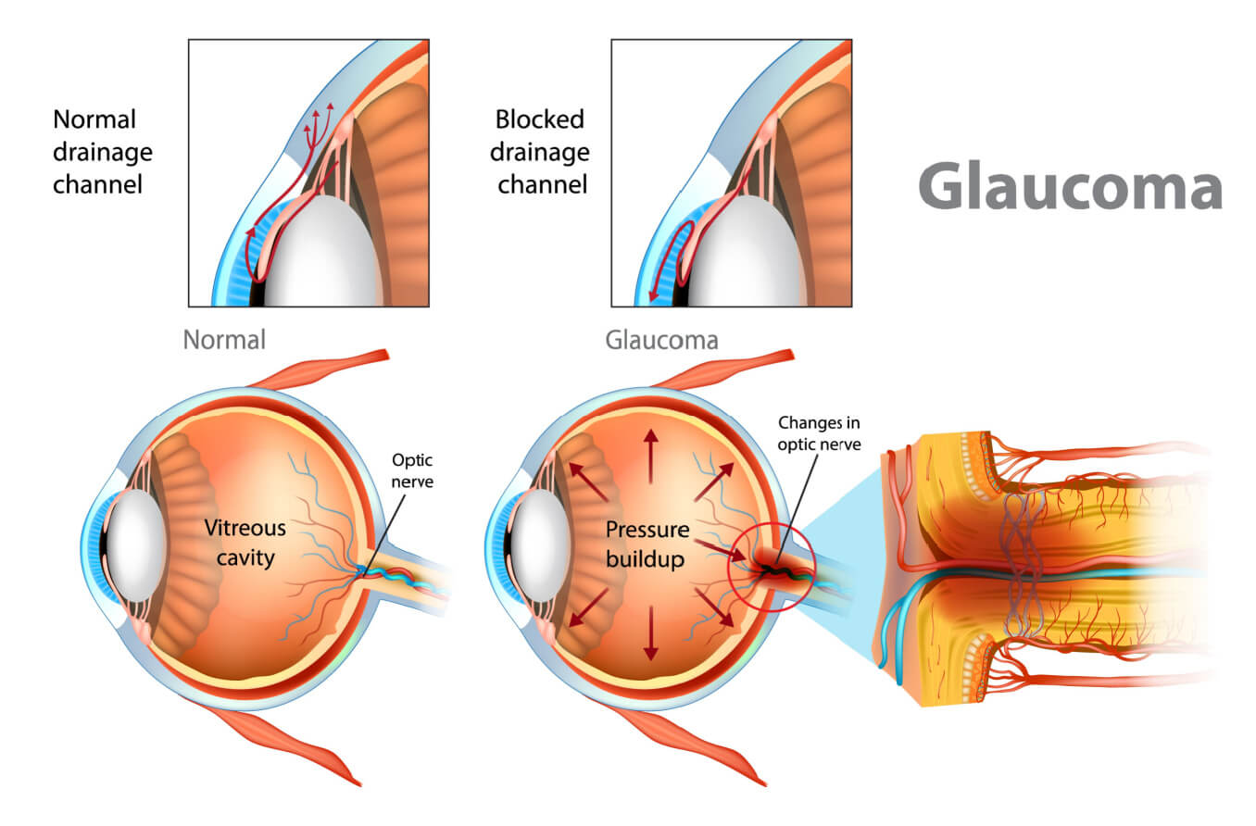

Slide 15

Glaucoma
Group of ocular conditions in which damage to the optic nerve is related to increased intraocular pressure (IOP) caused by excessive aqueous humor in eye
Third most common age-related eye disease
  Affects 3 million Americans
Incidence increases with age (most prevalent over age 40)
Common cause of blindness
Early diagnosis and treatment is essential to prevent vision loss
Regular glaucoma checks
  Tonometry to measure IOP
  Ophthalmoscopy to inspect optic nerve
  Central field visual testing

Slide 16
Glaucoma: Risk Factors
Smoking
Older age
Family history of glaucoma
Black or Asian race
History of diabetes, cardiovascular disease, and/or HTN
Trauma to the eye, including retinal detachment
Eye infection
Eye tumor
Decreased corneal thickness
Myopia

Slide 17
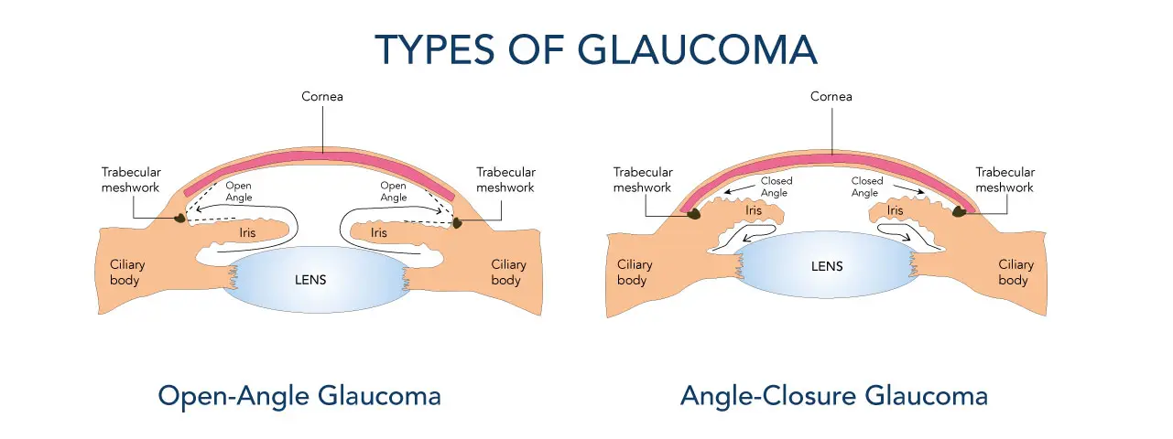

Slide 18
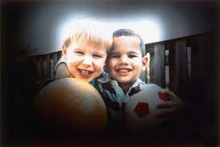
Open (Wide-Angle) Glaucoma
Most common form
Usually bilateral
Decreased outflow of aqueous humor outflow r/t blockage in the drainage system
Gradual rise in IOP due to reduced outflow of fluid
“Silent thief” of vision with gradual loss of peripheral vision
Often initially asymptomatic, mild eye pain, blurry vision, halos around lights, and HA can occur
Requires chronic lifelong treatment

Slide 19
Angle-Closure (Narrow-Angle) Glaucoma
Sudden closure of the angle, often r/t dilation of the pupil, rapidly increases the IOP to 30 mm Hg or higher
Ocular emergency that requires immediate treatment to lower IOP and prevent complications
Nursing interventions include treatment of severe pain and nausea
Manifestations
  Rapidly progressive visual impairment - reduced central visual acuity
  Severe eye pain that may be associated with N/V, bradycardia, profuse sweating, headache
  Corneal edema
  Pupil may be semi dilated, fixed and unreactive to light and accommodation

Slide 20
Glaucoma: Treatment
Goal is to prevent further optic nerve damage and vision loss
Maintain IOP within a range unlikely to cause damage (< 21 mm Hg)
Lifelong therapy for open angle glaucoma
Pharmacotherapy
Surgery
Laser trabeculectomy, iridotomy, or placement of shunts improve the flow by opening the channel out of the anterior chamber of the eye

Slide 21
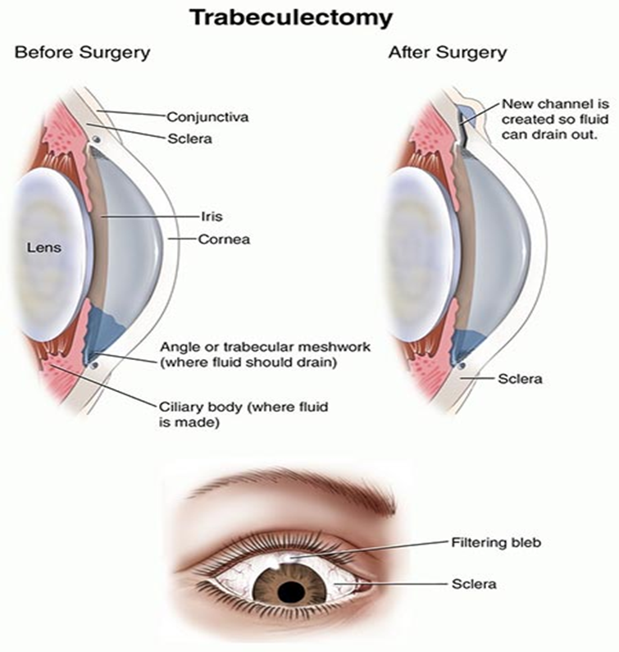
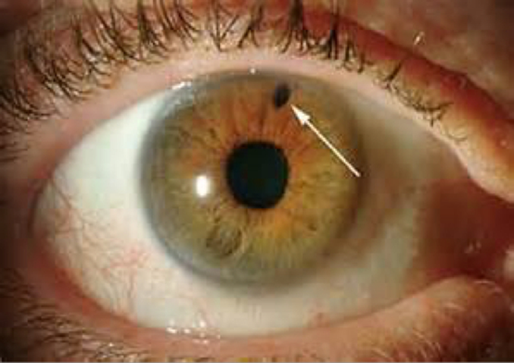
Iridotomy

Slide 22
Glaucoma: Post Operative Client Education
Wear sunglasses while outside or in brightly-lit areas
Report manifestations of infection, such as yellow or green drainage
Avoid activities that increase IOP – Which activities would the nurse discuss with the client?
Do not lie on operative side
Report severe pain or nausea as this can indicate possible hemorrhage
Final best vision occurs 4 to 6 weeks after surgery

Slide 23
Answer: activities that raise intraocular pressure
Straining: bending forward with the head below the waist, lifting more than about 5–10 lb, pushing, pulling and Valsalva – prevent constipation with fluids, fiber and stool softeners.
Coughing, sneezing and vomiting – treat nausea early and report it; hold the eye when a sneeze is unavoidable.
Rubbing or pressing on the eye; sleeping on the operative side; tight collars.
Vigorous exercise, swimming and contact sports until cleared; sexual activity until the surgeon allows.
Prolonged reading or screen work in the first days if it causes eye strain; wear the shield at night.

Slide 24
Glaucoma: Nursing Management
Monitor for increased IOP
Monitor for decreased vision or light sensitivity
Treat severe pain and nausea with analgesic and antiemetics (closed-angle)
Focus on maintaining the therapeutic regimen for lifelong control of a chronic condition (open-angle)
Emphasize the need for adherence to therapy and continued care to prevent further vision loss (open-angle)
Provide education regarding use and effects of medications

Slide 25
Cataracts
Opacity or cloudiness of the lens that impairs vision
Leading cause of blindness in the world
Leading cause of disability in the U.S.
By age 80, > 50% of all Americans have cataracts

Slide 26
Cataracts: Risk Factors
Aging
Family history
Trauma
Retinal detachment
Long-term steroid, beta-blocker, or miotic medications use
Smoking
Poor nutrition or obesity
Previous eye surgery
Hypertension
Excessive exposure to sunlight
Diabetes
Renal disorders
Excessive alcohol use

Slide 27
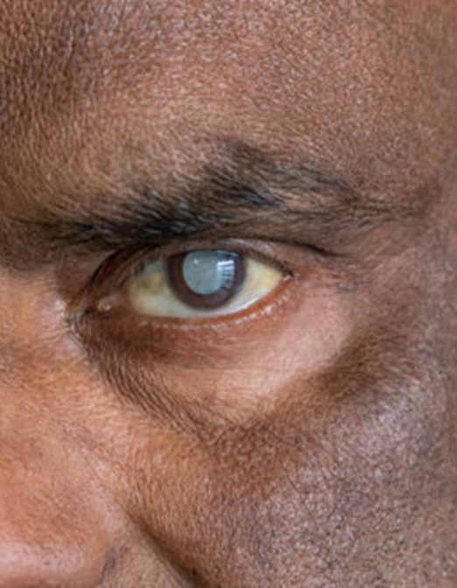
Cataracts:
Clinical Manifestations
Painless, progressive blurry vision
Reduced night vision
Sensitivity to glare of light
Reduced visual acuity
Prescription changes
Decreased color perception
Myopic shift (return of ability to do close work)
Diplopia in a single eye
Color shifts as lens becomes more brown
Opacity of the lens

Slide 28
Cataracts: Nursing Management
Check visual acuity with Snellen chart
Determine the client’s functional capacity
Increase the amount of light in the room
Provide adaptive devices for reduced vision:
Magnifying lens
Large print
Talking devices

Slide 29
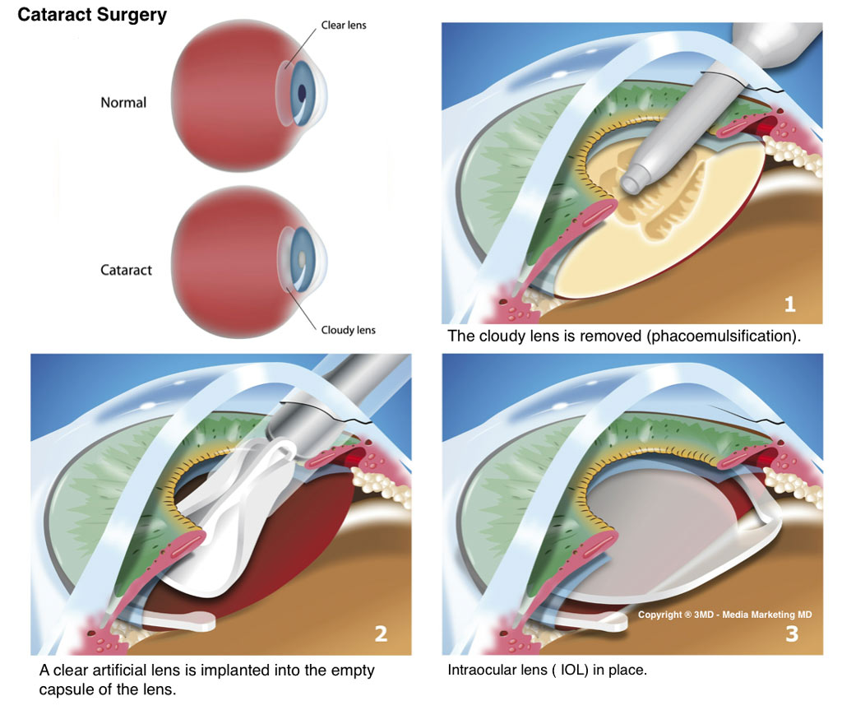
Cataracts: Surgical Management
If reduced vision does not interfere with normal activities, surgery is not needed
Lens removal and replacement surgery is performed on an outpatient basis with local anesthesia
  Surgery usually takes <1 hour & clients are discharged soon afterward
  Small incision made
  Lens removed
  Replacement lens is inserted
    Replacement lenses can correct refractive errors which result in improved vision

Slide 30
Case Study: Client Teaching Post Cataract Removal
An 82-year-old client had right-eye cataract surgery and implant of an intraocular lens. The nurse provides discharge instructions; special wraparound sunglasses; a padded, metal eye protector for bedtime; and a prescribed antibiotic, corticosteroid, and NSAID eye drops.)
What discharge instructions should the nurse provide?
What instructions should the nurse provide on applying eye drops?

Slide 31
Answer: discharge teaching after cataract surgery
Discharge instructions
  Wear the wraparound sunglasses outdoors and the metal shield at night and during naps for about a week; do not rub or press on the eye.
  No bending below the waist, lifting over 5–10 lb, straining, or sleeping on the operative side; avoid coughing and constipation; no swimming, eye makeup or dusty work until cleared.
  Expect mild scratchiness and blurred vision at first; report sudden or severe pain, nausea, flashes of light, a curtain over the vision, or increasing redness or discharge – these can mean hemorrhage, rising pressure, infection or retinal detachment.
  Take the antibiotic, steroid and NSAID drops exactly as scheduled; keep the follow-up appointment (usually the next day); arrange a ride home and help for 24 hours; final vision at 4–6 weeks.
Applying the eye drops
  Wash hands; tilt the head back, pull down the lower lid, look up, drop into the pocket without touching the eye; close gently and press the inner corner for a minute; wait 5 minutes between different drops; wipe inner to outer; never share bottles.

Slide 32
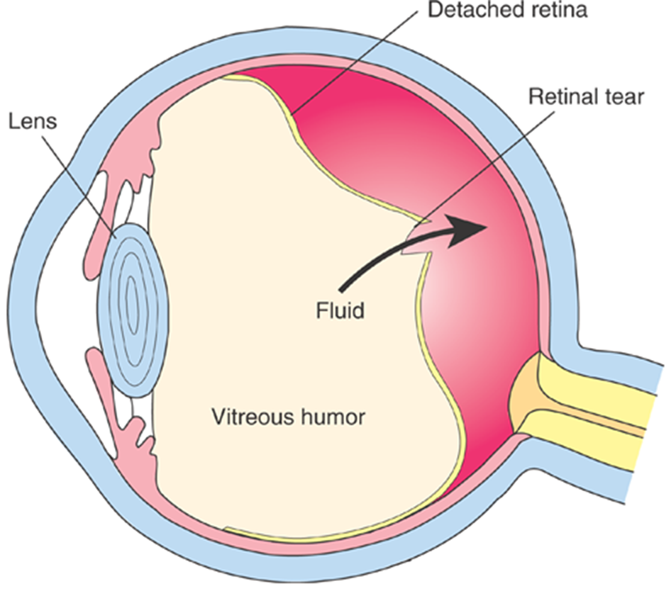
Retinal Detachment
Separation of the sensory retina and the retinal pigment epithelium (RPE)
Hole or tear develops in the retina
Liquid vitreous seeps through and causes the retina to detach
This is an ocular emergency!
Clinical manifestations
  Sensation of a shade or curtain coming across the vision of one eye
  Bright flashing lights
  Sudden onset of floaters
  Clients do NOT complain of pain

Slide 33

Retinal Detachment: Surgical Treatment
Scleral Buckle
Band compresses the sclera and brings 2 layers of retina together
High success rate
Vitrectomy
Dissection of preretinal membranes and retinal stabilization using an intraoperative vitreous substitute
Frequently used in combination with other procedures
Pneumatic Retinopexy
Injected gas bubble, liquid, or oil is used to flatten the sensory retina
Pt must remain PRONE to keep gas bubble lying over the area of detachment to provide consistent pressure to reattach the sensory retina

Slide 34
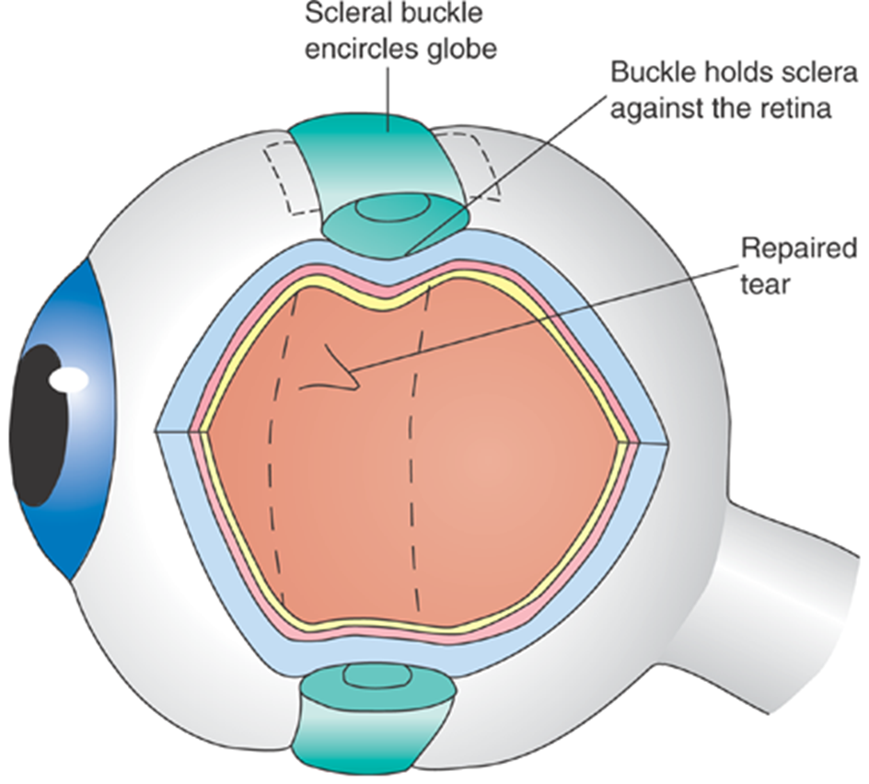
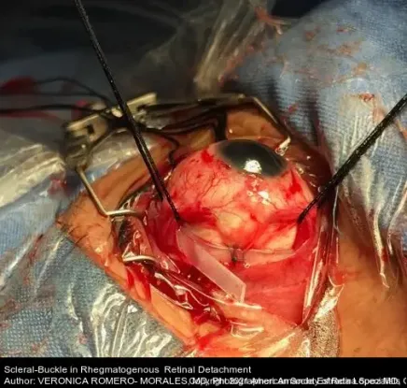
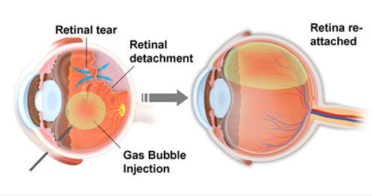

Slide 35
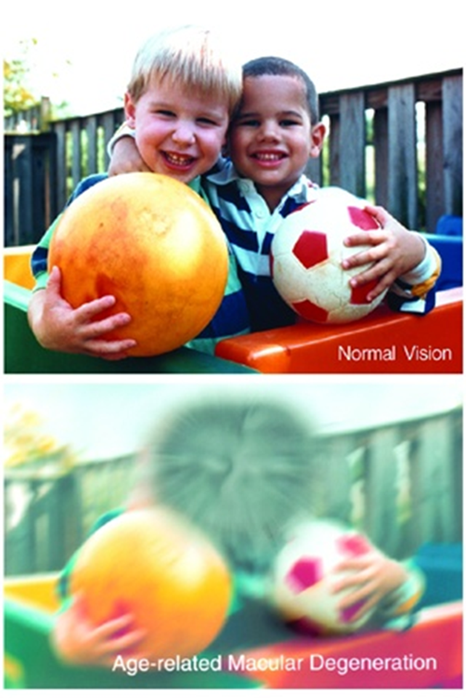
Age-Related Macular Degeneration (AMD)
Irreversible loss of central loss vision that affects the macula
Most common cause of vision loss in persons older than age 60
Appearance of drusen
Manifestations
  Lack of depth perception
  Objects appear distorted
  Blurred vision
  Loss of central vision
  Blindness

Slide 36
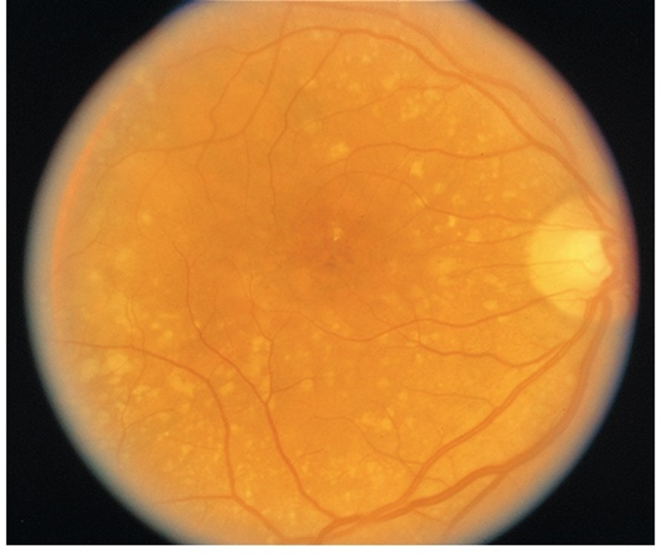
Types of Macular Degeneration
Dry
  Most common type
  Caused by gradual blockage in retinal capillary arteries
    Leads to ischemia and necrosis
Wet
  Less common
  Caused by growth of new blood vessels of thin walls
  Lead to vessels leaking blood and fluid
  Can occur at any age

Slide 37
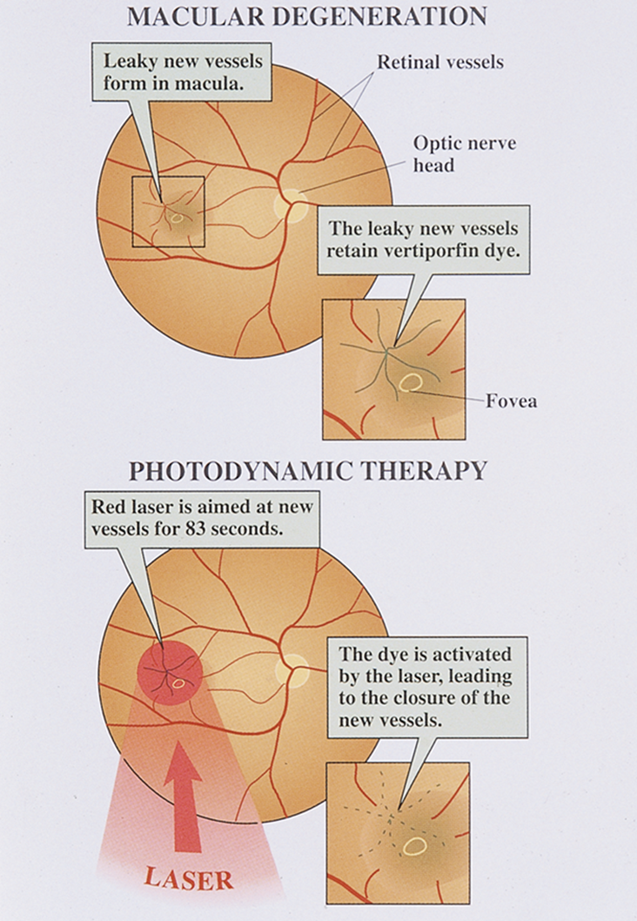
Macular Degeneration: Treatment
Laser therapy to seal leaking vessels
Ocular injections
Client education
  Consume foods high in antioxidants, carotene, vitamins E and B12
  May be prescribed a supplement high in carotene and vitamin E
  As loss of vision progresses, client will be challenged with ADLs, along with their ability to drive, write, and read
  Refer the client to community organizations
  Assist with transportation, reading devices, large-print books

Slide 38
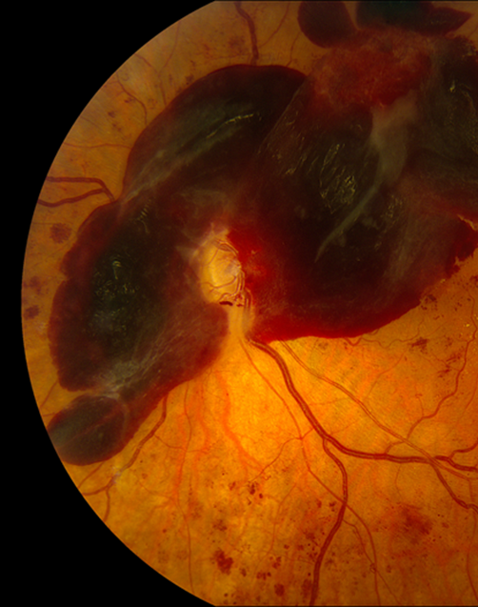
Diabetic Retinopathy
Microvascular (changes in small blood vessels) complication of diabetes that results in micro aneurysms, retinal ischemia, and hemorrhage
Initial focus of management is primary and secondary prevention: Maintenance of normal blood glucose levels, control of HTN, smoking cessation
Symptoms may include floaters, blurred vision, dark areas of vision
Nursing management involves implementing an individualized plan of care and providing client education
Advanced cases may require laser treatment or surgery

Slide 39
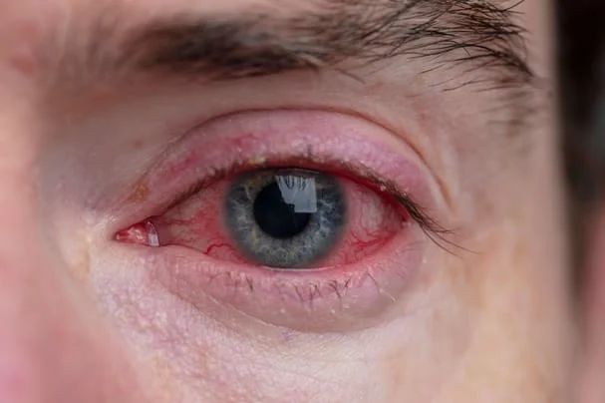
Conjunctivitis
Irritation and inflammation of the conjunctival lining of eye
Manifestations: burning, “gritty” sensation, itching, redness, photophobia, drainage
Classified by cause: allergic, bacterial, viral
Bacterial and viral conjunctivitis are highly contagious
  Can easily spread from one eye to the other

Slide 40

Conjunctivitis: Client Education
What teaching would the nurse provide to a client with conjunctivitis?
Allergic
Bacterial
Viral

Slide 41
Answer: conjunctivitis teaching
All types
  Wash hands often and before and after touching the eyes; do not rub; use a clean tissue or washcloth for each eye and each wipe; no eye makeup or contact lenses until it clears; discard old makeup.
Allergic
  Not contagious. Avoid the allergen, cool compresses, artificial tears, antihistamine or mast-cell-stabilizer drops; oral antihistamines for itching.
Bacterial
  Highly contagious. Antibiotic drops or ointment for the full course; warm compresses to loosen crusts; wipe inner to outer canthus; separate towels and pillowcases; stay home from school or work until 24 hours of antibiotics.
Viral
  Highly contagious for up to 2 weeks. Supportive: cool compresses, artificial tears; antibiotics do not help; strict hand hygiene, no sharing towels, disinfect surfaces; stay home while the eye is red and watering; see the provider for pain, light sensitivity or vision change.

Slide 42
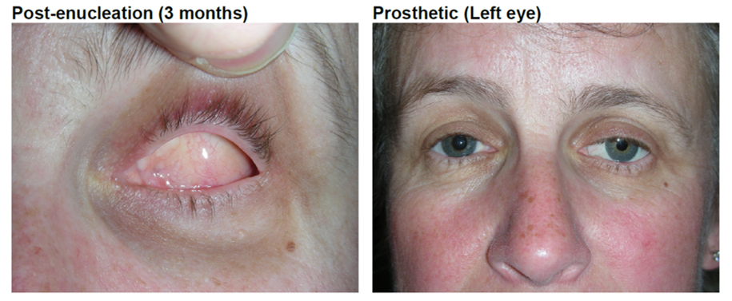
Enucleation
Removal of the eyeball (globe) from the orbit
Ocular prosthesis: Nursing considerations
  Will have large ocular pressure dressing removed after a week
  Ophthalmic topical antibiotic ointment is applied in the socket three times daily
  Client has loss of depth perception; use extra caution with ambulation
  Collaborate for ocular prosthesis referral
  If conformers/prosthesis accidentally fall out of the socket, wash, dry, place back in.

Slide 43
Disorders of the Ear

Slide 44
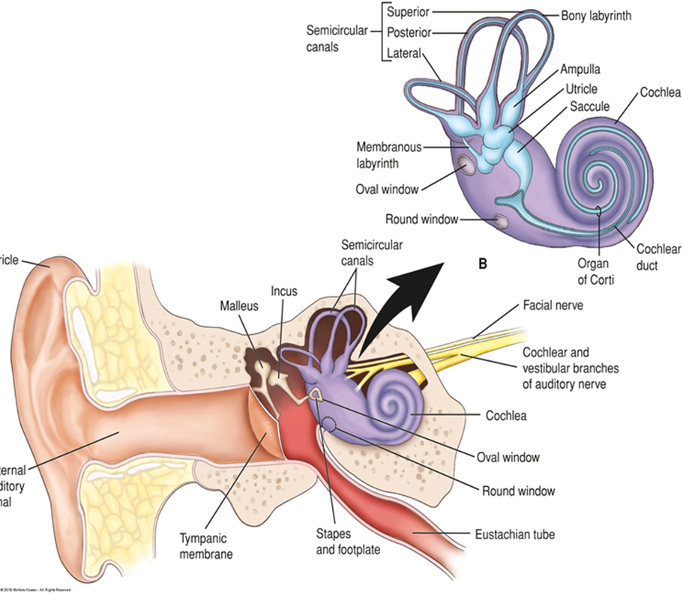
Anatomy of the Ear

Slide 45
What strategies would the nurse include in the plan of care for clients with hearing disorders?
Identify manifestations that may be exhibited by a client with a hearing disorder.

Slide 46
Answer: hearing disorders – manifestations and the plan of care
What you may see
  Asking for repetition, turning the head or cupping the ear, TV turned up loud, speaking too loudly or too softly, answering inappropriately, withdrawing from conversation, irritability, tinnitus, dizziness, or a child who is slow to speak.
Communication strategies
  Get the client’s attention first; face the client in good light so lips can be read; speak clearly at a normal pace and slightly louder without shouting; lower the pitch; short sentences; rephrase rather than repeat; reduce background noise; write it down; use pictures and gestures.
Plan of care
  Make sure hearing aids are in, on, clean and charged; keep them safe; provide an amplifier or interpreter for the Deaf client; flag the chart and door; safety – visual alarms, vibrating alerts, extra care with alarms and call lights; involve family; refer to audiology and support groups; assess for depression and isolation.

Slide 47
Hearing Loss
Occurs in 2 to 3 of every 1000 births in the U.S.
Presbycusis
Risk factors
Family history
Congenital malformations
Ototoxic medications
Recurrent ear infections
Exposure to loud noises
Perforation of tympanic membrane

Slide 48
Types of Hearing Loss
Conductive
Due to external canal or middle ear problem
Often caused by otitis media, otosclerosis, foreign bodies, ear wax
Sensorineural
Due to damage to the cochlea or vestibulocochlear nerve (CN VIII)
Mixed
Both conductive and sensorineural
Functional
Psychogenic
Due to emotional reaction

Slide 49

Hearing Loss: Clinical Manifestations
Early symptoms
  Tinnitus “ringing in the ears”
  Difficulty hearing in a group
  Turning up the volume on the TV
Impairment may be gradual and not recognized by the person experiencing the loss
As hearing loss increases
  Deterioration of speech
  Fatigue
  Indifference
  Social isolation or withdrawal

Slide 50
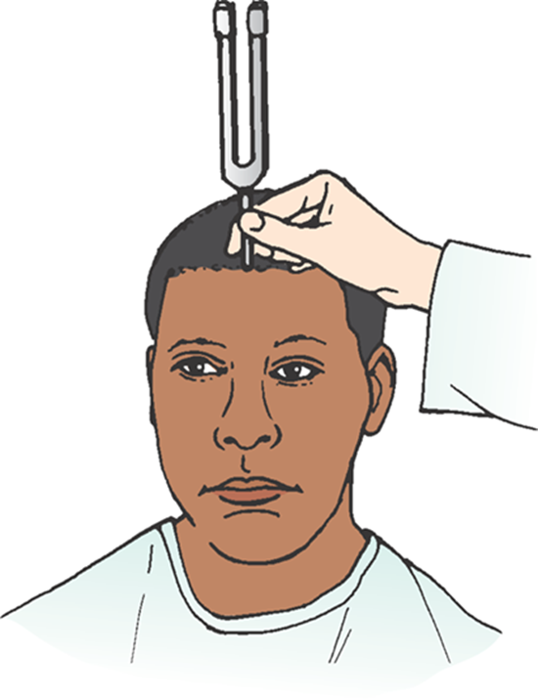
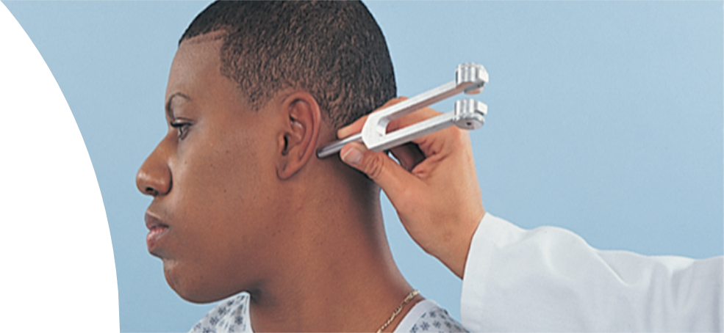
Diagnostics: Sound Conduction
Weber test
Rinne test
Bone conduction of sound
Used to establish a diagnosis in clients with unilateral hearing loss
Assesses both air and bone conduction of sound of affected ear
Useful for distinguishing between conductive and sensorineural hearing loss

Slide 51
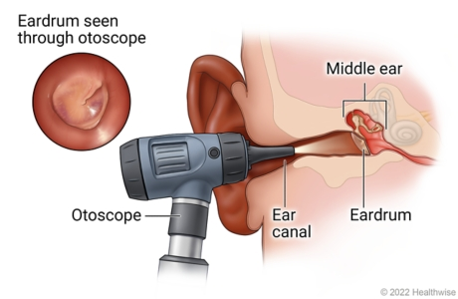
Diagnostic Procedures
Otoscopy – nursing assessment
Audiometry
Tympanogram
Electronystagmography (ENG): used in vertigo testing
  Assesses vestibular function
  Performed by physician or audiologist
  Nurse’s role

Slide 52
Answer: the nurse’s role in ear diagnostics
Otoscopy is a nursing assessment: pull the pinna up and back in adults (down and back in children under 3), inspect the canal and the tympanic membrane – pearly gray, cone of light at 5 o’clock on the right and 7 o’clock on the left.
Explain each test, what the client will hear or feel, and how long it takes; check for cerumen first because it blocks results.
Audiometry and tympanogram: quiet room, remove hearing aids, teach the client to signal each tone.
Electronystagmography: NPO and no caffeine, alcohol, sedatives or antihistamines for 24–48 hours as ordered; expect dizziness and nausea; arrange a ride; safety after the test.
Document findings, teach the client the results, and refer to audiology or ENT.

Slide 53
Cochlear Implant
Auditory prosthesis that consists of a microphone, speech processor, transmitter and receiver that converts sounds into electric impulses and electrodes that are attached to the auditory nerve
Transmitter is located outside the head behind the ear and connects via magnet to the receiver located immediately below it, under the skin
Controversy with many within the Deaf community
Those who were born totally deaf adapt more slowly
Intense, prolonged language training needed for those who did not develop speech
Client education
Unit is not turned on immediately after surgery
External unit is applied, and the speech processor is programmed 2 - 6 weeks after surgery
Avoid MRIs

Slide 54

How a Cochlear Implant Works
Notes:
https://www.youtube.com/watch?v=io2ujVWguF0

Slide 55
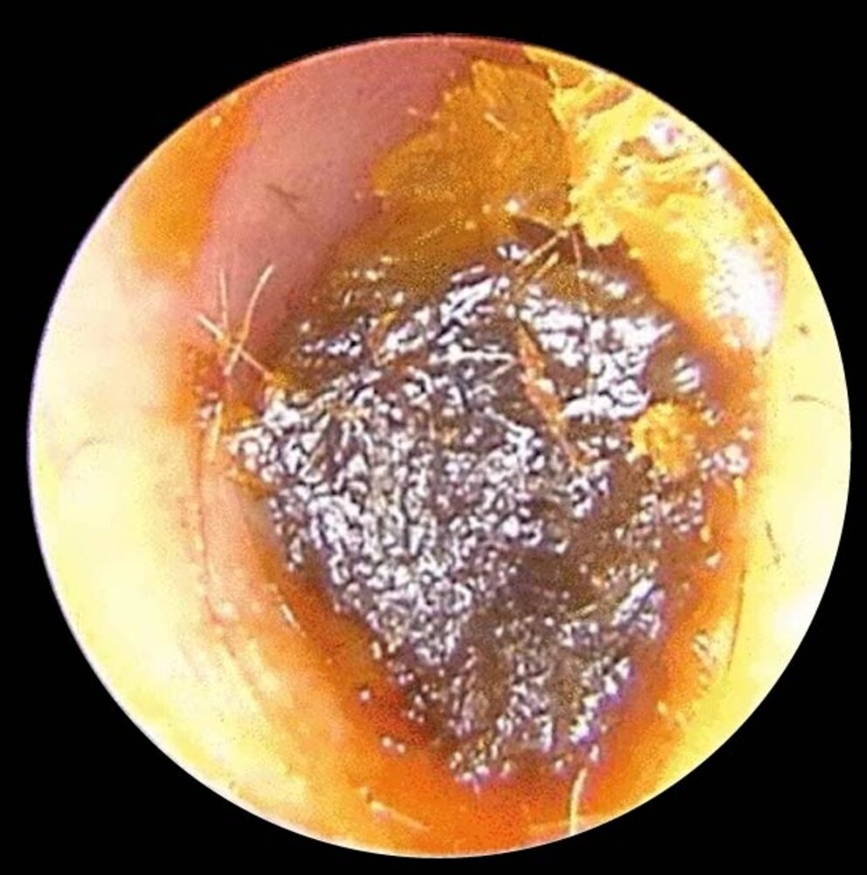
Cerumen Impaction
Common cause of conductive hearing loss
Removal may be by irrigation, suction, or instrumentation
Gentle irrigation should be used with lowest pressure, directing stream behind the obstruction
Glycerin, mineral oil, half-strength H₂O₂ or peroxide in glyceryl may help soften cerumen
Candles contraindicated

Slide 56
Otitis Externa
Inflammation/infection of the external auditory canal most commonly due to a bacterial or fungal infection
Manifestations
Pain and tenderness
Discharge
Edema and erythema of canal
Pruritus
Hearing loss
Feelings of fullness in the ear

Slide 57
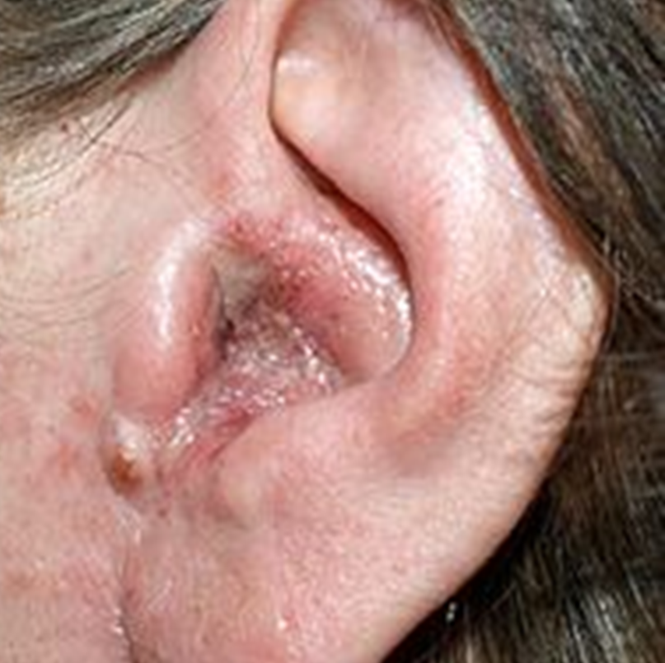
Otitis Externa: Treatment
Goals of therapy include reducing discomfort, reducing edema, and treating the infection
Antimicrobial or antifungal otic meds given by dropper at room temperature

Slide 58
Acute Otitis Media
Acute viral or bacterial infection of the middle ear
Most common in children
Lasts less than 6 weeks
What are the clinical manifestations of acute otitis media?
Medical management
Surgical treatment

Slide 59
Answer: acute otitis media
Clinical manifestations
  Ear pain (pulling at the ear in infants), fever, irritability, poor sleep and feeding, fullness and reduced hearing; on otoscopy a red, bulging, immobile tympanic membrane with no cone of light; drainage if it ruptures, which also relieves the pain.
Medical management
  Pain control with acetaminophen or ibuprofen and warm or cool compresses; watchful waiting for 48–72 hours in mild cases; amoxicillin (high dose) first-line, amoxicillin-clavulanate if it fails; finish the whole course; no antihistamines or decongestants for children.
Surgical treatment
  Myringotomy with tympanostomy tubes for recurrent or persistent effusion; the tubes fall out on their own in 6–12 months; keep water out of the ears per the surgeon; report drainage. Adenoidectomy if adenoids are the cause.
Prevention
  Pneumococcal and yearly influenza vaccines, breastfeeding, feeding upright not lying down, no bottle in the crib, no smoke exposure, hand hygiene.

Slide 60
Chronic Otitis Media
Recurrent infection of the middle ear and/or mastoid air cells in the presence of a tympanic membrane perforation
Can lead to irreversible damage and scarring
Symptoms commonly include hearing loss, aural fullness, otalgia, otorrhea, and occasionally vertigo.
Treated with topical antibiotics

Slide 61
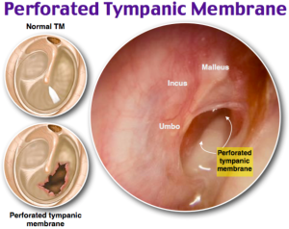
Tympanic Membrane Perforation
Usually caused by infection or trauma
  Otitis media, nearby explosion, severe blow to ear, deep diving
Manifestations
  Sudden loss of hearing
Often heals spontaneously in weeks to several months
Tympanoplasty
  Surgery for TM perforation
  Tissue is placed across the perforation to allow healing and improves hearing
What nursing care should be provided to a client with a TM perforation?

Slide 62
Answer: nursing care for a tympanic membrane perforation
Keep the ear dry: no swimming, and cotton with petroleum jelly or an ear plug in the shower; do not put drops in unless prescribed for it.
Do not blow the nose forcefully; sneeze with the mouth open; avoid air travel and diving until healed.
Nothing in the ear canal – no cotton swabs or irrigation.
Antibiotic drops or oral antibiotics as prescribed for infection; analgesics for pain.
Report fever, worsening pain, drainage, dizziness or hearing that gets worse; most heal on their own in weeks to months, otherwise tympanoplasty.
Hearing loss is expected until it heals – use the communication strategies for hearing impairment and keep the client safe.

Slide 63
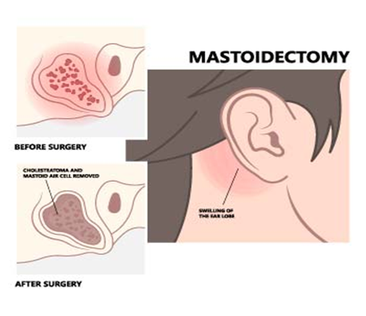
Middle Ear Surgical Procedures
Tympanoplasty: Reconstruction of the tympanic membrane
Mastoidectomy: Removal of diseased bone, mastoid air cells, and cholesteatoma to create a non-infected, healthy ear
Notes:
Reduce anxiety
Reinforce information and client teaching
Provide support and allow client to discuss anxieties
Relieve pain
Medicate with analgesics for ear discomfort
Occasional sharp/shooting pains may occur for 2-3 weeks
Constant throbbing pain and fever may indicate infection and should be reported to the healthcare provider
Prevent Infection
Monitor for signs and symptoms of infection
Elevated temperature, purulent drainage should be reported
Administer antibiotics as ordered
Prevent contamination of ear with water from showers, washing hair, etc. for 6 weeks
A cotton ball covered with petroleum jelly placed loosely in ear canal
Improve communication and hearing
Hearing may be reduced for several weeks following surgery due to edema, accumulation of blood and fluid in the middle ear, and dressings and packings
Prevent injury
Implement safety measures such as assisting with ambulation
Provide antiemetics or antivertigo medications
Medication teaching: analgesics and antivertigo medications
Activity restrictions
Avoid nose blowing for 2-3 weeks after surgery; sneeze and cough with mouth open
Client may need instruction to avoid heavy lifting, exertion, and nose blowing to prevent dislodgement of grafts or prostheses
Safety issues related to potential vertigo
Instruction regarding potential complications and reporting of problems
Facial nerve injury, infection, taste disturbances
Report excessive or purulent ear drainage
Avoid getting water in ear
Follow-up care

Slide 64
Discuss nursing interventions for a client undergoing a middle ear surgical procedure.
Reduce anxiety
Relieve pain
Prevent Infection
Improve communication and hearing
Prevent injury
Client teaching
Medication
Activity
Safety
Complications
Follow-up care

Slide 65
Answer: nursing interventions after middle ear surgery (1 of 2)
Reduce anxiety and relieve pain
  Explain what to expect, allow questions; analgesics for ear pain; occasional sharp shooting pains are normal for 2–3 weeks, but constant throbbing pain with fever means infection – report it.
Prevent infection
  Keep the dressing and ear dry; change the outer cotton as it becomes soiled; antibiotics as prescribed; report fever, foul or increasing drainage.
Improve communication and hearing
  Packing and edema reduce hearing for weeks – face the client, speak clearly, write things down; reassure that hearing improves as packing is removed.

Slide 66
Answer: nursing interventions after middle ear surgery (2 of 2)
Prevent injury
  Vertigo and dizziness are common: bed low, rails up, help with walking, move slowly, avoid sudden head turns; no driving until cleared.
Teaching – activity and safety
  Avoid straining, heavy lifting, bending, coughing and nose-blowing (mouth open to sneeze) for about 2–3 weeks; no air travel or swimming until cleared; keep the head elevated; lie on the unoperated side; no water in the ear; no hair washing for the first days.
Complications and follow-up
  Report facial weakness or drooping (facial nerve), sudden hearing loss, severe vertigo, stiff neck or headache; keep follow-up for packing removal and hearing tests.

Slide 67
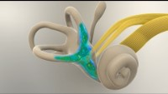
Ménière Disease
Notes:
https://www.youtube.com/watch?v=qrk7OyAB_ss

Slide 68
Ménière Disease
Abnormal inner ear fluid balance in vestibular system
Chronic condition
Affects over 600,000 people in the U.S. with more than 45,000 new cases annually
Genetic predisposition
Manifestations
  Fluctuating, progressive hearing loss
  Tinnitus
  Feeling of pressure or fullness
  Episodic, incapacitating vertigo that may be accompanied by N/V

Slide 69
Ménière Disease: Treatment
Low-sodium diet
1000-1500 mg a day
Sodium and fluid retention disrupts the balance of fluid in the inner ear
Pharmacotherapy
Antihistamines (meclizine)
Tranquilizers (diazepam)
Antiemetics
Diuretics (Spironolactone, HCTZ)
Surgical management to eliminate attacks of vertigo not responsive to conventional therapy

Slide 70
Other Inner Ear Conditions
Tinnitus
Toxicity of which medication can cause tinnitus?
Vertigo
Benign paroxysmal positional vertigo
Labyrinthitis
Otosclerosis

Slide 71
Answer: tinnitus – which drug toxicity?
Aspirin (salicylate) toxicity is the classic cause – ringing in the ears is an early warning sign of salicylism, along with dizziness, nausea and hyperventilation.
Other ototoxic drugs that cause tinnitus: aminoglycosides (gentamicin, tobramycin), loop diuretics (furosemide, especially IV push too fast), cisplatin, vancomycin, quinine and chloroquine, high-dose NSAIDs, and some antidepressants.

Slide 72

What are nursing priorities of care for clients with inner ear disorders?

Slide 73
Answer: nursing priorities for inner ear disorders
Safety first: fall precautions during vertigo – bed low, rails up, sit before standing, move slowly, assist with walking, no driving or operating machinery during attacks.
During an attack: lie still in a dark, quiet room with the head elevated; avoid sudden head movements and bright or flickering lights; provide an emesis basin.
Give antivertigo and antiemetic drugs as ordered (meclizine, diazepam, promethazine, ondansetron) and diuretics for Ménière; monitor for drowsiness.
Ménière teaching: low-sodium diet (1,000–1,500 mg), limit caffeine, alcohol and nicotine, keep fluids even through the day, keep a symptom diary of triggers.
Hydration and nutrition during vomiting; assess hearing and tinnitus; emotional support – unpredictable attacks are frightening and isolating.
Vestibular rehabilitation and Epley maneuver for BPPV; teach when to seek care (new neurologic signs, hearing loss).

Slide 74
List common ototoxic medications.
What are priorities of nursing care for a client receiving ototoxic medications?

Slide 75
Answer: ototoxic medications and nursing priorities
Common ototoxic drugs
  Aminoglycosides (gentamicin, tobramycin, amikacin, neomycin, streptomycin); vancomycin; loop diuretics (furosemide, bumetanide, ethacrynic acid); salicylates and NSAIDs in high doses; cisplatin and carboplatin; quinine and chloroquine; erythromycin IV; some antivirals.
Nursing priorities
  Baseline hearing and balance assessment before therapy; ask about tinnitus, fullness, dizziness or reduced hearing at every assessment – the loss is often permanent, so early detection matters.
  Monitor kidney function (BUN, creatinine, urine output) and drug levels (peak and trough for aminoglycosides and vancomycin); dose by renal function; keep the client hydrated.
  Give IV furosemide slowly (no faster than 4 mg/min for large doses) and aminoglycosides over the ordered time; avoid combining two ototoxic drugs when possible.
  Teach the client to report ringing, dizziness or hearing change immediately and not to add aspirin or NSAIDs on their own; safety precautions for dizziness; audiology follow-up.

